Slide 1



Banking
Opportunity identification through factors
07 OCT 2019
ANKANA TECHNOLOGIES

Slide 2

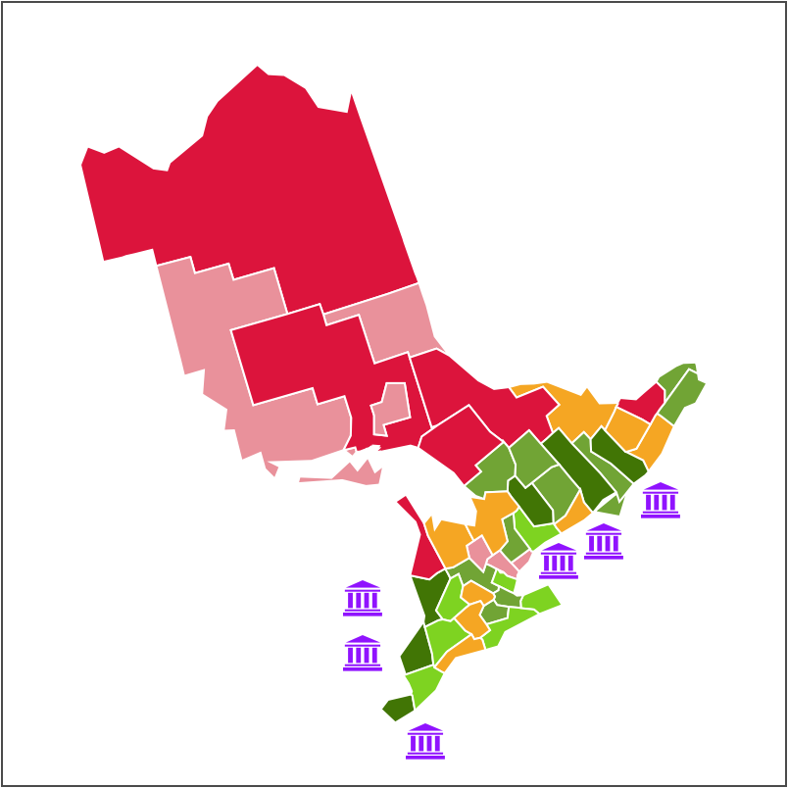

What banks like to achieve
Growth in existing business
Expand to new territories
Cross-sell products
Custom solutions for business problems

Slide 3
How data can help
With data we can achieve these goals
Growth in existing business
Identify potential gaps across different factors using demographics, socio-economic and industry presence data.
Expand to new territories
Identify potential locations across the country where services can best match.
Cross-sell products
Deep analysis on products and identify potential channels to cross sell them.
Custom solutions to business problems
Strategize sales and marketing approach, by answering business problems.

Slide 4
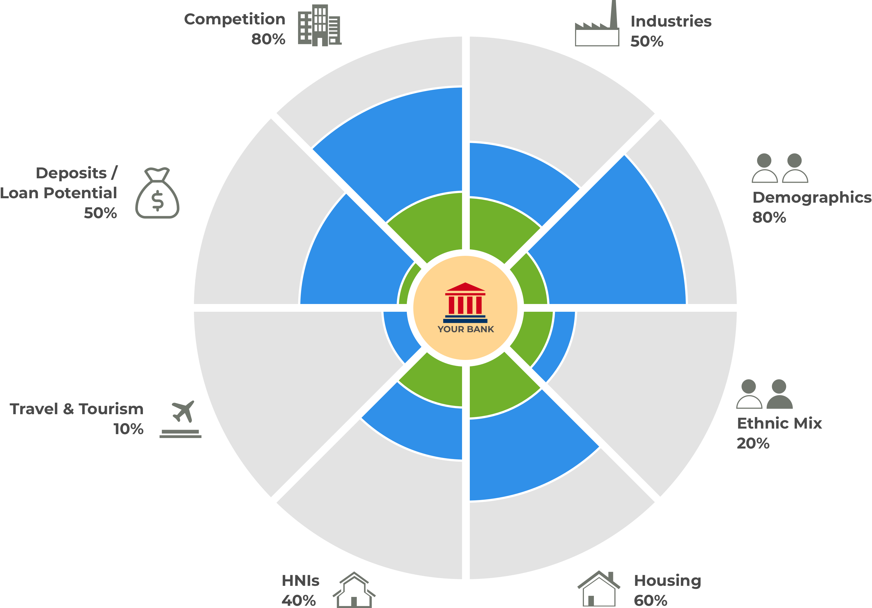
What are the factors / dimensions

Slide 5
What are the factors / dimensions
Banking presence and competition
Banking products presence
What industries are predominant
Potential industries to target
Loan potential and business loans
Potential demographics attribute to consider
Socio Economic factors
International ports
Tourism and currency exchange
Presence of ethnic mix
Immigrants and aboriginals
Presence of HNIs
Trade and commercial activities
Housing market
Loan potential for housing

Slide 6
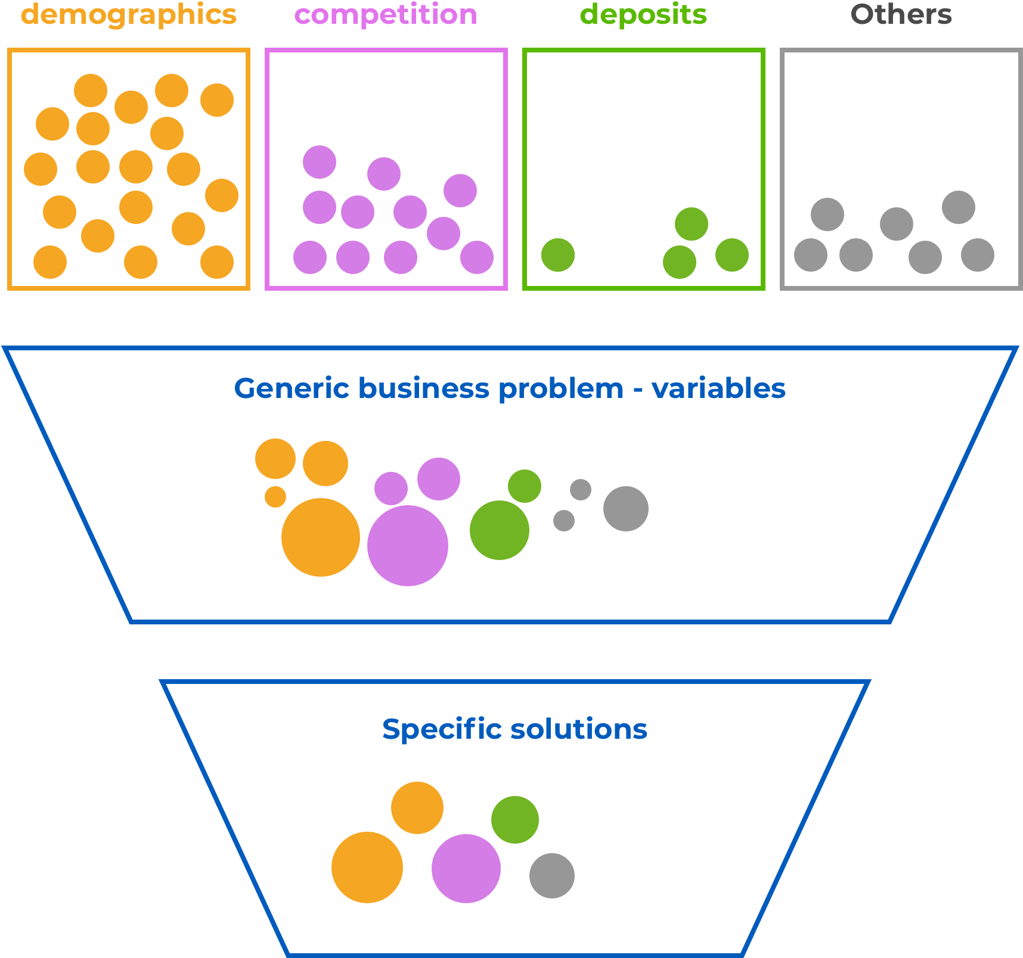
Approach
There are numerous variables that can be considered from various data.
To address certain business problems (like top locations to expand), finite variables are considered and given weightage.
The result can be further customized based on specific bank / a service / or other combinations.

Slide 7
Results and recommendations
By analyzing the business problems; insights are derived and recommended. The results can be presented in a infographic rich presentation.
Following are some of the insights that can be derived:
Potential locations for new branches
Identify potential services (location based)
Loans potential (location/industry based)
Targeted banking (location based)

Slide 8
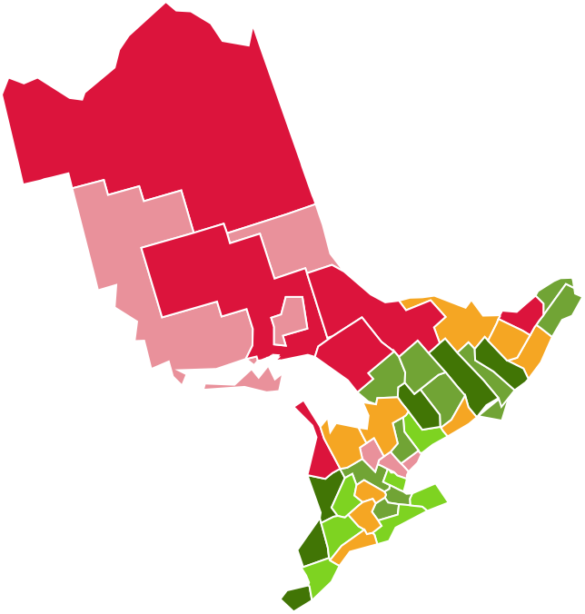
Example
Business problem: Which are the potential counties to set up a bank branch in Ontario.
Approach
Explore through Heat map: Plot heat map of counties based on calculated index (high to low).
Deepdive through Radial map: For individual counties plot a radial map showing gap in potential and achieved.
Insights and Recommendations: Actionable insights and recommendations. Rankings, index values and observations.

Slide 9
Appendix

Slide 10
Demographic Variables
Sex
Age Group
Education
Occupation
Income Group
Status
Household Size
Ethnicity
Immigration, etc

Slide 11
Competition variables
Banks list
Branches across the country
Services offered
Bank size

Slide 12
Industry Presence
Major industries in a location
Industry size and turnover
Employment
Tourism
International Ports

Slide 13
HNI Presence
Presence of HNIs in a location
HNI associated industries

Slide 14
Deposits
Deposits in a area or sub-division
Loan potential - weighted with deposits
Investments in the area
Housing in the area

Slide 15

THANK YOU
adarsh@ankana.tech
website
ankana.tech

